Slide 1
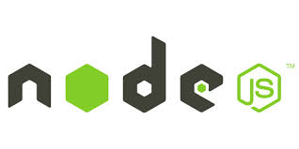
Introduction to Node JS
Prepared By
Gaurav Khurana

Slide 2
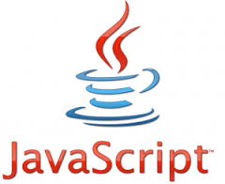

JavaScript and You
The first incarnations of JavaScript lived in browsers
At the end of the day you were, at best, a JavaScript user, but not a JavaScript developer.
What you really wanted was "the real thing", for that we learned PHP, Ruby, Java and started writing “back end” code.
And then came Node.js. JavaScript on the server, how cool is that?
In 2009 Ryan Dahl created Node.js
Node.js does its magic, by making use of Google's V8 VM

Slide 3
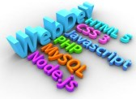
Why Node Js?
Scalable Server Side JavaScript.
Faster as its mostly C Code.
In addition to speed, Node brought an unconventional execution model to the table.
Node.js ships with a lot of useful modules.
In order to write Node.js applications in a fashion that makes you feel you are not just using JavaScript, you are actually developing it.

Slide 4

What Could you Build ?
Web Socket Server
Fast File Upload Client
Ad Server
Any real time Data App
Thus, with the invention of Node, JavaScript finally became a bona fide server-side language.

Slide 5

What is Node Js not?
A web frame Work
Multi-Threaded (You can think of it as a single threaded server)

Slide 6
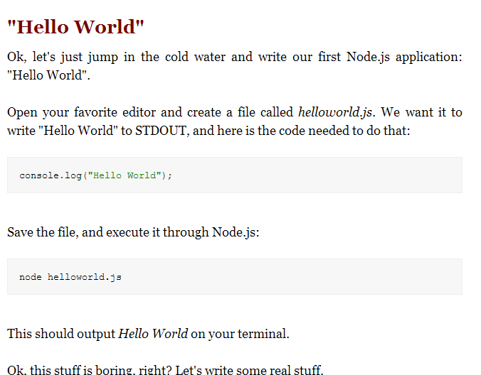

Lets get started by traditional Hello World

Slide 7
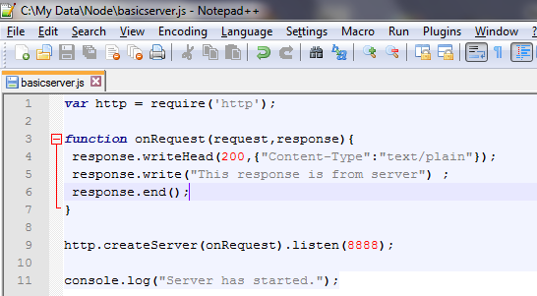

Lets Write some Real Stuff

